Slide 1
Company Name: ECOPRESS INNOVATIONS
MOTTO: Effortless Squeeze, Faster Dry
Project Title: Effortless Squeeze Revolution"
S.No | Name of the student | Year/Dept. | Email Id
1 | PURUSHOTHAMAN A | ^{2rd} yr/ECE | Purushotharun2005@gmail.com
2 | RAJKUMAR R S | ^{2rd} yr/ECE | rs.rajkumar2005@gmail.com
3 | THOMAS LIVINGSTON G | ^{2rd} yr/ECE | thomaslivingston31306@gmail.com

Slide 2

EFFORTLESS SQUEEZE REVOLUTION
PURUSHOTHAMAN A
RAJKUMAR R S
THOMAS LIVINGSTON G

Slide 3
Problem Statement
Squeezing excess water from clothes after washing is a physically demanding and time-consuming task. Manual methods often leave clothes damp, leading to increased drying time and potential mold growth, especially in humid environments. Additionally, squeezing clothes by hand can cause discomfort, particularly for the elderly or those with limited physical strength. While mechanical solutions like spin dryers exist, they are costly, energy-consuming, and often impractical for smaller households. Existing hand wringers or tools are either bulky, difficult to use, or designed for larger-scale commercial use, making them inefficient for home use. Moreover, many of these solutions rely on electricity, raising concerns about their environmental impact. There is a clear need for an affordable, efficient, and ergonomic device that makes the process of squeezing clothes easier, faster, and more sustainable, addressing the needs of a wide range of users.

Slide 4

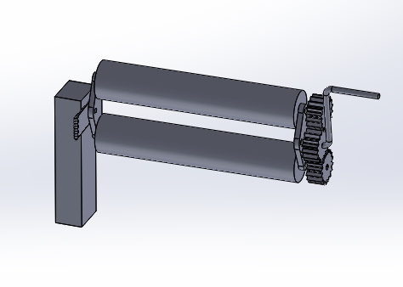
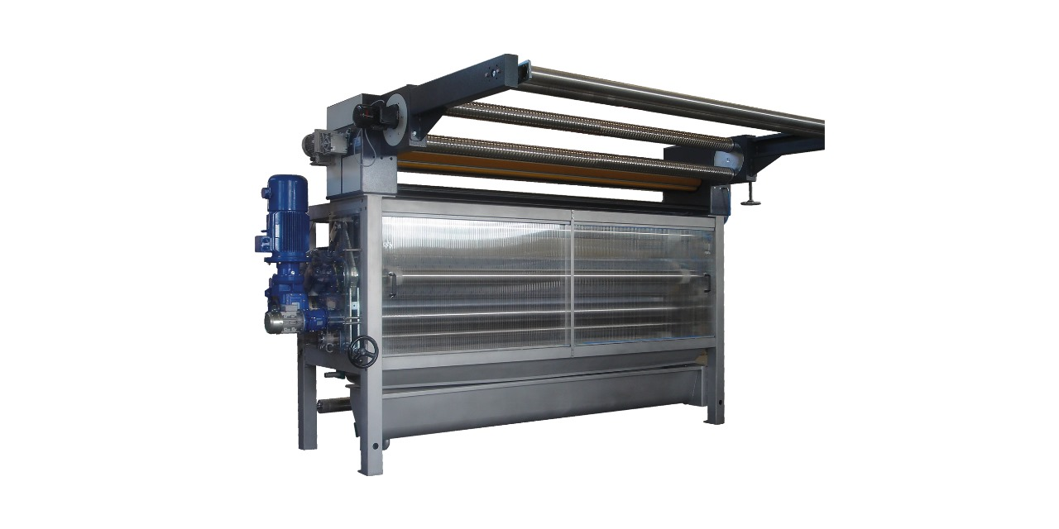
Existing Product Detail

Slide 5
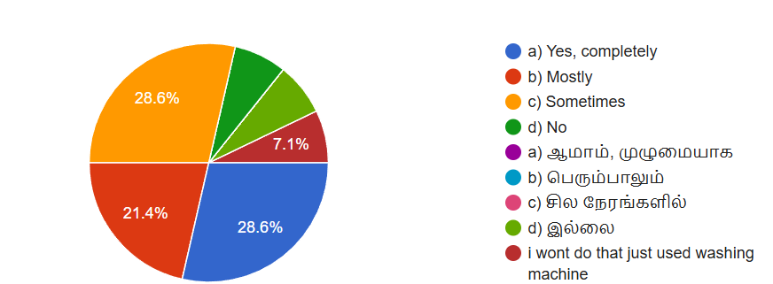
HIGHLIGHTED SURVEY REPORT
Does squeezing protect your hands from strain?

Slide 6
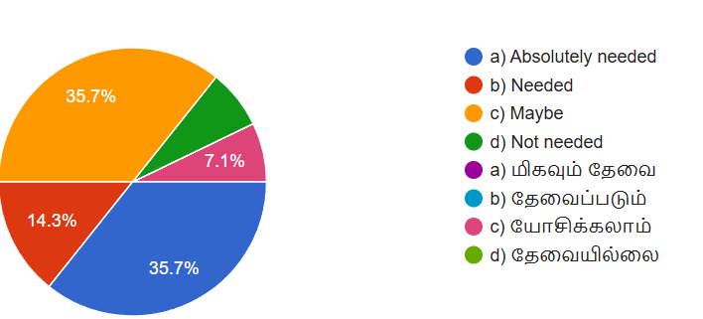
Do you feel the need for a device or solution for squeezing?

Slide 7
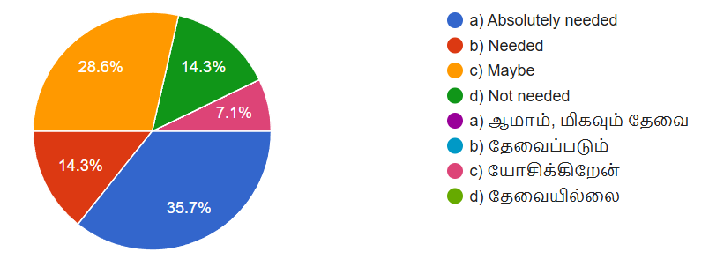
Do you feel the need for mechanical assistance while squeezing?

Slide 8
Solution (Or) Proposed Design

Slide 9
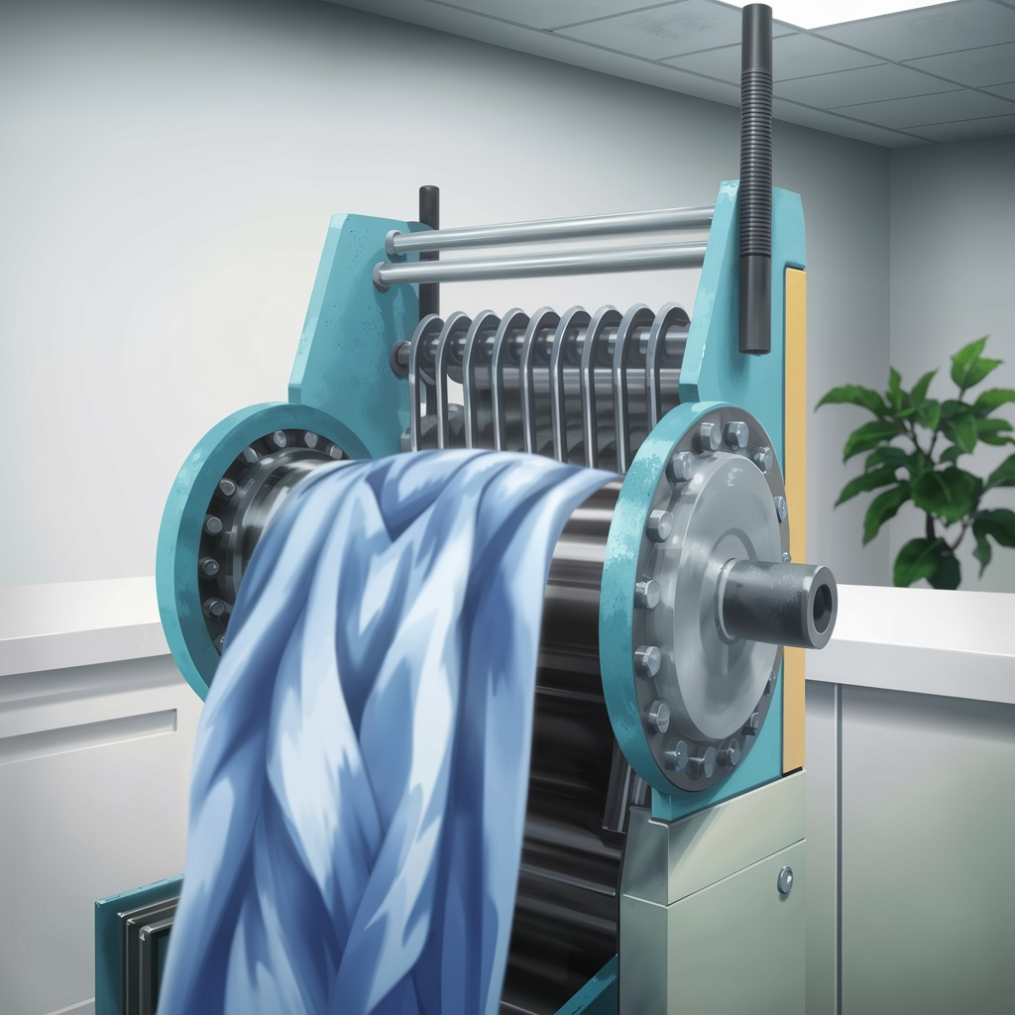
Working Of Invention

Slide 10
Target Marketing
Homeowners.
Travelers (e.g., backpackers, campers).
Laundry businesses and dry cleaners.
Hotels and hospitality industry.
Eco-conscious consumers.

Slide 11
Competitor Analysis
Alternate Solutions
Target Market Limitation: Aimed mainly at industrial-scale users.
High Cost: Expensive, which might not be suitable for small-scale or individual users.
Size and Portability: Large and immobile, requiring significant space and installation.

Slide 12
My Solution Product
Compact and Portable: Smaller size, ideal for households or small businesses.
Manual Operation: No need for electricity, making it eco-friendly and cost-effective.
Affordable: Lower manufacturing and retail costs compared to industrial competitors.
Simple Maintenance: Easy to repair or replace individual components.
User-Friendly: Detachable gears and rollers for flexibility and easy handling.

Slide 13
Value Proportion
Reduces strain, particularly for seniors or people with disabilities.
Saves time and effort.
Portable and compact—suitable for both home and travel use.
Accelerates squeeze time, reducing mildew risk.

Slide 14
Channels For Marketing
E-commerce Platforms
Company Website
Social Media
Influencer Marketing
Email Marketing
Content Marketing
Online Advertising
Retail Partnerships
Customer Referral Program

Slide 15
Revenue Model
Direct Sales
Wholesale Distribution
Bundling with Other Products
Customization and Personalization
Online Advertising and Affiliate Marketing
Product Licensing and Distribution
Corporate Sales
E-commerce Marketplace

Slide 16
MARKETING STATERGY
Market Analysis
- Target Audience: Homeowners, restaurants, cleaning services.
- Competitor Analysis: Pricing, quality, distribution channels of competing products.
- SWOT Analysis: Strengths (durability), Weaknesses (possible rusting), Opportunities (eco-friendly options), Threats (Spin squeeze competition).
Product Positioning
- Unique Selling Proposition (USP): Durable, eco-friendly, and efficient in reducing squeezing time.
- Brand Messaging: "Simplify Laundry, Save Time!"
- Pricing Strategy: Competitive pricing with tiered options for bulk purchases.

Slide 17
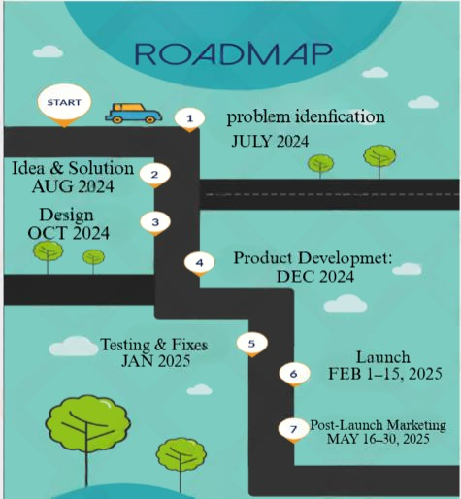
ROAD MAP

Slide 18
THANK YOU!

